Slide 1
Humans
By: Kshitiz Srivastava

Slide 2
Perception
Perception is the sensory experience of the world. It involves both recognizing environmental stimuli and actions in response to these stimuli. Through the perceptual process, we gain information about the properties and elements of the environment that are critical to our survival.

Slide 3
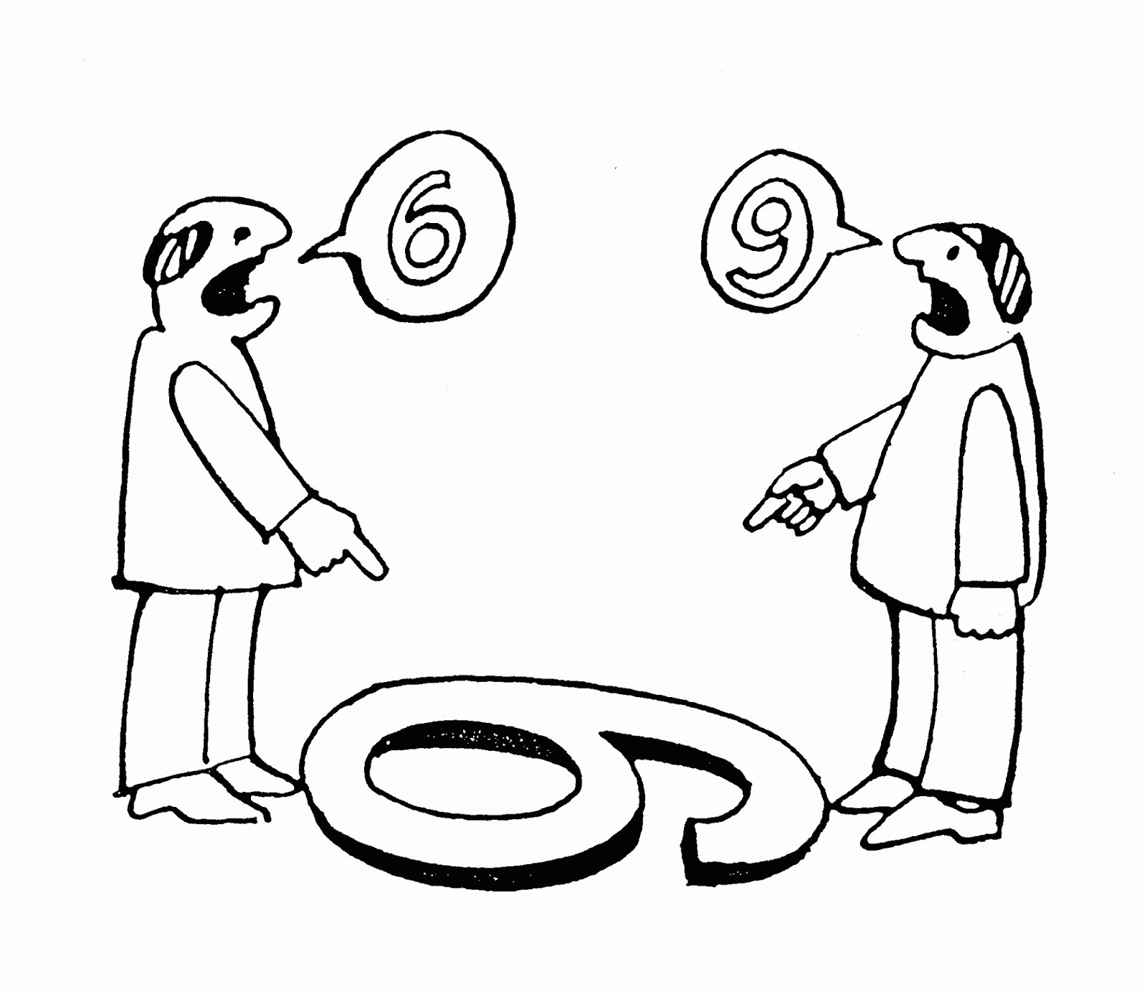

Slide 4
Perception (Key Point)
Top-down processing occurs when people form perceptions based on prior experiences, general concepts, and expectations.
Bottom-up processing occurs when people form perceptions through sensory data.

Slide 5
Perception (Key Point)
A schema is a mental shortcut, a way to interpret incomplete information.
JNDs (just noticeable differences) describe the smallest detectable difference between two levels of stimuli.

Slide 6
Perception (Key Point)
People notice the relative change in stimuli, not the absolute.
We perceive objects placed next to one another/ similar to one another, as a group.

Slide 7
Attention
Inattention blindness causes users to sometimes overlook easily seen information.
Users are less able to notice something when it happens infrequently.
Automatic processing handles routine and predictable tasks.
Controlled processes command a user’s attention.

Slide 8
Attention
Unfamiliar experiences and complex actions require controlled attention.
Users expend cognitive resources when viewing information.
Attention span fluctuates based on a user’s age, culture, and context.
Users’ sustained attention lasts for approximately 10 minutes.

Slide 9
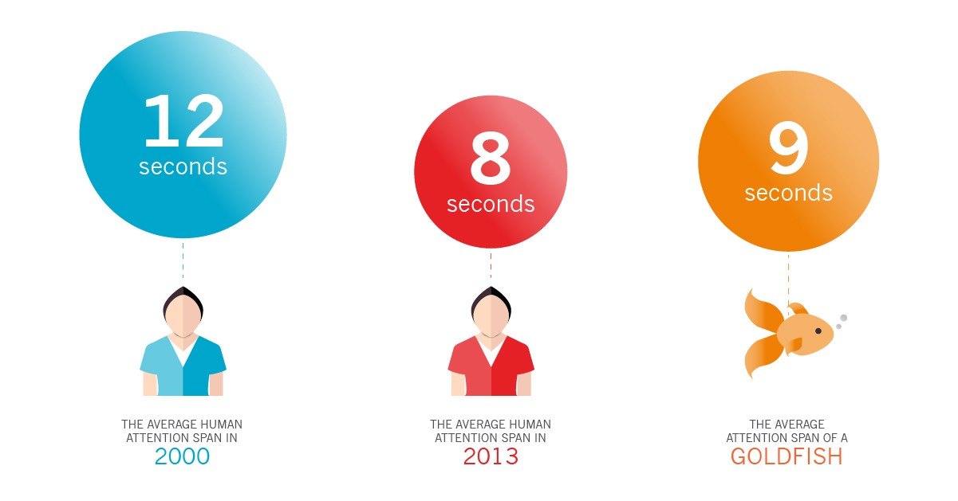
Attention

Slide 10
Flow
Relationships with users depend a series of repeated, connected experiences.
In a flow state, our attention is balanced between arousal and control.
Flow states alter time; long periods of time shorten.
Business applications must flow to remain competitive.

Slide 11
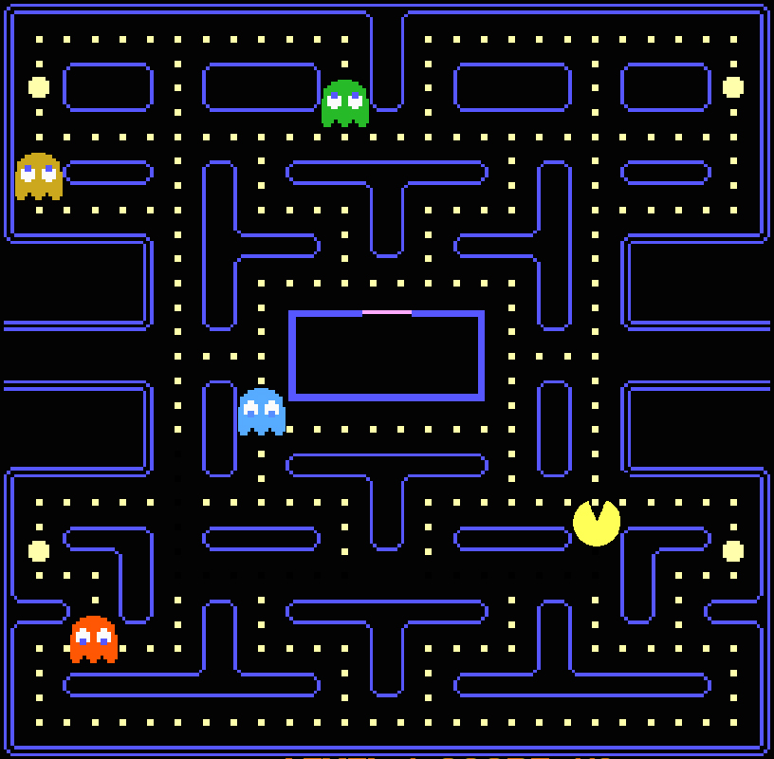

Slide 12
Laziness
People seek information using the most convenient, fastest method available.
Remove obstacles within an experience to hasten the completion of user goals.

Slide 13


Slide 14
Memory
Interference diminishes a users’ ability to store and retrieve short-term memories.
Persist important information within a user’s view, because out of sight really is out of mind.
Recognizing data is frequently easier than recalling data .
You consciously recall explicit memories (e.g., passwords).

Slide 15
Memory
Implicit memories are unconsciously remembered (e.g., how to use a fork).
Over time, explicit memories may become implicit memories.
Schemas aide our ability to quickly retrieve memories.
The primacy effect helps users recall the first few items in a list.

Slide 16
Memory
The recency effect helps users recall the last few items viewed in a list.
Behaviors are enforced by successful outcomes and eroded by unsuccessful attempts.
Memories are imperfect and may change over time.

Slide 17
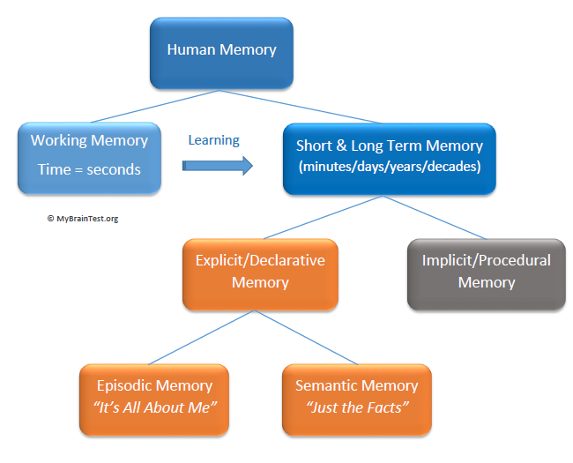

Slide 18
Mental Models
Mental models are how we understand the world. Not only do they shape what we think and how we understand but they shape the connections and opportunities that we see. Mental models are how we simplify complexity, why we consider some things more relevant than others, and how we reason.

Slide 19
Mental Models
A mental model is simply a representation of how something works. We cannot keep all of the details of the world in our brains, so we use models to simplify the complex into understandable and organizable chunks.

Slide 20
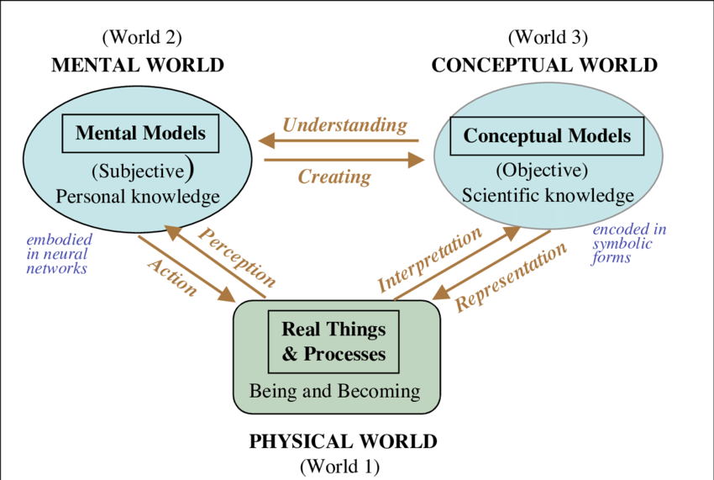

Slide 21
THANKU

